Slide 1

Study of Sales through Customer Behaviour

Slide 2

MOTIVATION
Black Friday! An extravaganza of sales, promotions, and long lines outside of stores.
Retailers (such as Target, Best Buy, Amazon, and many others) hopes that consumers will take advantage of door-busting deals.
But, How ?? how the retailers provide us with such good deals ?

Slide 3


BLACK FRIDAY DATASET
Purchase summary of various customers for selected high volume products of a retail company “ABC Private Limited” with respect to customer demographics.

Slide 4


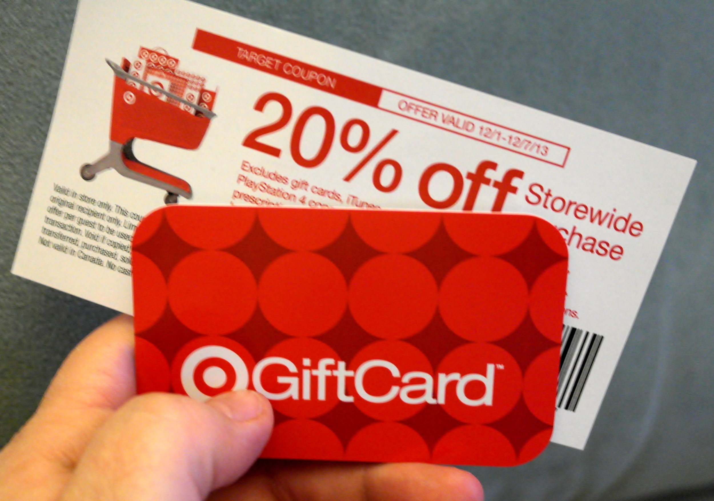
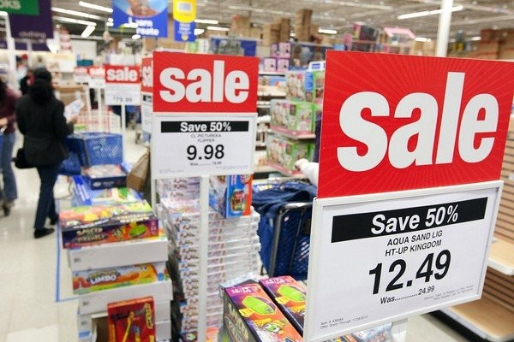

OBJECTIVE
Predicting the amount of purchase of a customer on black friday
in order to provide promotional offers for a retail store ABC Pvt Ltd. ?
Developing customer segments to define marketing strategy based
on their spending habits ?
Attempting to associate products in order to perform product recommendation
and organize store layout.

Slide 5
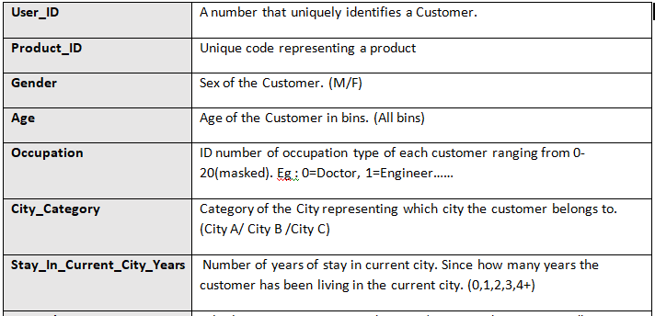
DATA DESCRIPTION
Dimension : 538k x 12

Slide 6
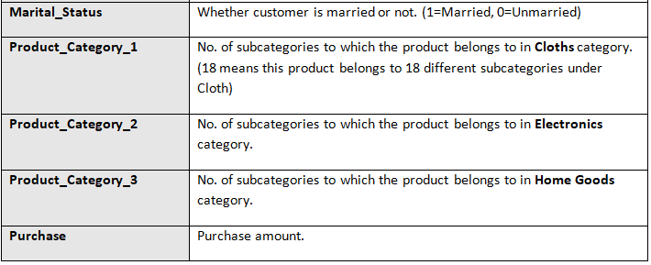
DATA DESCRIPTION (Contd..)
NOTE : > A customer has bought multiple products and a product has been bought by multiple customers.
> A Product can belong to multiple subcategories. For example, running shoes belong to both fashion and sports categories.

Slide 7

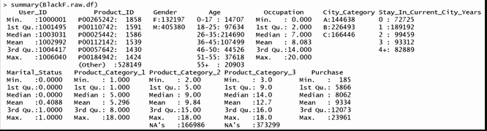
DATA EXPLORATION
No outliers
Missing values in Product_Category_2 & Product_Category_3

Slide 8
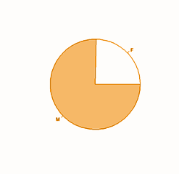
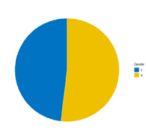
DATA EXPLORATION (Contd..)
Analysis of variable - GENDER
CUSTOMER RATIO (Based on gender) PURCHASE RATIO(Based on gender)
- M - F

Slide 9
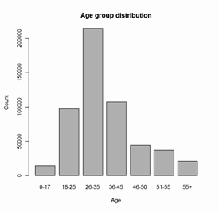
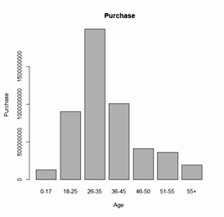
DATA EXPLORATION (Contd..)
Analysis of variable - AGE
AGE GROUP DISTRIBUTION (Over Count) PURCHASE DISTRIBUTION

Slide 10
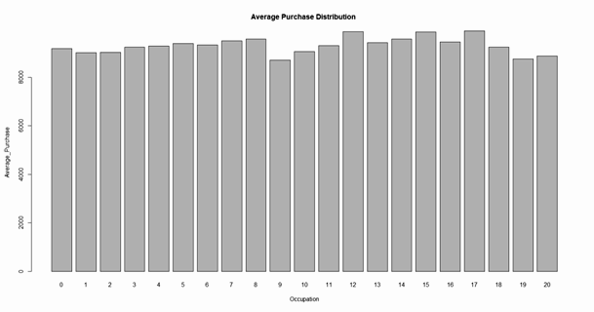
DATA EXPLORATION (Contd..)
Analysis of variable - OCCUPATION
PURCHASE DISTRIBUTION
Average is more / less same for all occupations.
Masked Data

Slide 11
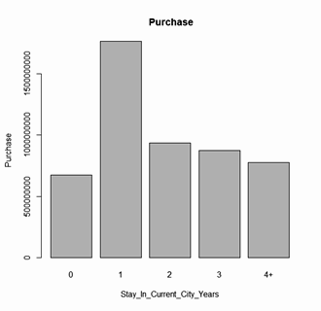
DATA EXPLORATION (Contd..)
Analysis of variable - STAY IN CURRENT CITY YEARS
PURCHASE DISTRIBUTION
New residents will take advantage of the low prices or offers on Black Friday to purchase all things needed.

Slide 12
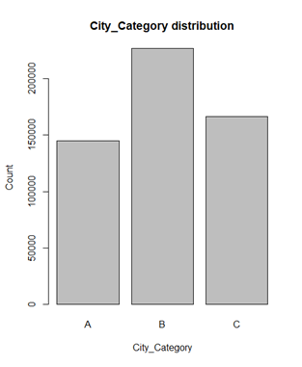
DATA EXPLORATION (Contd..)
Analysis of variable - CITY CATEGORY
More shoppers from City B

Slide 13

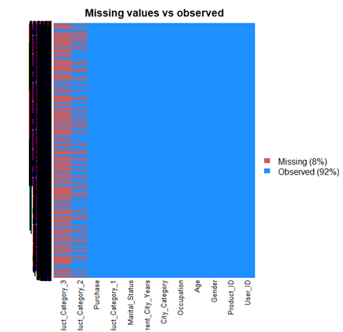
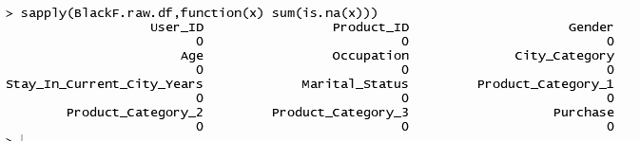
DATA CLEANING & PRE-PROCESSING
IMPUTING MISSING VALUES (Product Category 2 & Product Category 3)

Slide 14
DATA CLEANING & PRE-PROCESSING(Cont..)
REMOVING CUSTOMER ID AND PRODUCT ID
Unique ID's.
Not a customer purchase characteristic.
REMOVING OCCUPATION
Average is more / less same for all occupations.
Masked Data
Doesn’t provide us much information regarding purchase amount

Slide 15
DATA CLEANING & PRE-PROCESSING(Cont..)
ALTERING TYPE OF FEATURES
Age to Continuous categorical variable with 7 factor levels. Creating dummies we lose information Mean of the range provided is taken. For example, for ‘0-17’, we impute 8.5. | Marital status to factor categorical feature is identified as an integer value type (0/1). Make it factor | Stay in current city to continuous This feature can very well be continuous. (0,1,2,3,4+) Encoded 4 in the place of 4+, interpret 4 as 4 or more years. (No negative impact)

Slide 16
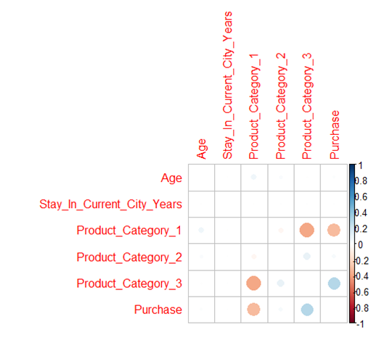
RELATIONSHIP AMONG FEATURES
Purchase highly correlated with :
Product_Category_1
Product_Category_3
No multicollinearity

Slide 17

MODEL BUILDING
SUPERVISED LEARNING
MULTIPLE LINEAR REGRESSION MODEL
How can we predict the amount of purchase of a customer by analysing customer purchase behaviour in order to provide promotional offers?

Slide 18
MULTIPLE LINEAR REGRESSION MODEL :
MODEL SPECIFIC PRE-PROCESSING :
Dummy Creation for categorical variables: Gender, City_Category , Marital Status
Data Partitioning (Train/Valid/Test)
SELECTING BEST SUBSET OF PREDICTORS:
Used Exhaustive Search.
select the best subset of predictors based on adj R2 : 5,6,7 Predictors

Slide 19
MULTIPLE LINEAR REGRESSION MODEL (Contd..):
MODEL SELECTION (Based on Valid Data) :
MODEL 1:
RMSE: 4639.693
MODEL 2:
RMSE: 4637.758
MODEL 3:
RMSE: 4637.501

Slide 20
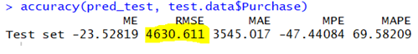
MULTIPLE LINEAR REGRESSION MODEL (Contd..):
BEST MODEL : Model 3
MODEL APPLICATION ON TEST DATA (Unseen Data):
It turns out that our prediction accuracy, is even better than on validation data.
So, we can conclude that our model will predict Consumer purchase amount for any new customer accurately.

Slide 21
MODEL BUILDING
UNSUPERVISED LEARNING
CLUSTERING USING K-PROTOTYPES
Can we develop a customer segmentation to define marketing strategy
based on their spending habits?

Slide 22






WHY K-PROTOTYPE:
Hierarchical clustering
Gower
Ward/Complete Linkage…. : Solution :- K-Medoid (Memory Overflow)
Non- Hierarchical clustering
K- Means (Because of Euclidean distance)
Solution -> K- Prototype :
Mixed[Mean(Numerical features) + Mode(Categorical Features)]

Slide 23
CLUSTERING USING K PROTOTYPE:
ENCODING THE FACTOR VARIABLES:
Gender into binary: 0- Female, 1-Male
City_Category as : 1 - City A, 2- City B, 3- City C
For easy calculation and interpretation
SCALING DATA:
Normalizing Numerical data (Range of 0 to 1).
For distance calculation

Slide 24
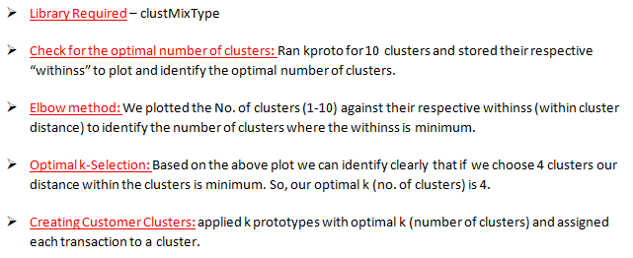
CLUSTERING USING K PROTOTYPE:
APPLICATION OF K-PROTOTYPE :

Slide 25
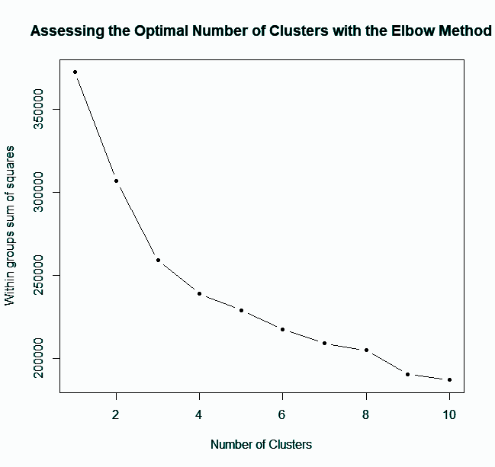
CLUSTERING USING K PROTOTYPE:
PLOT :

Slide 26
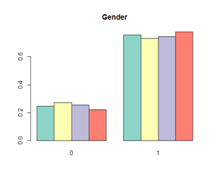
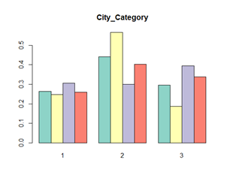
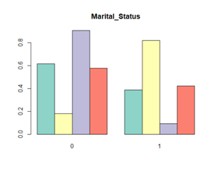
CLUSTERING USING K PROTOTYPE:
RESULTS :
Visualizing cluster distribution of categorical data.

Slide 27
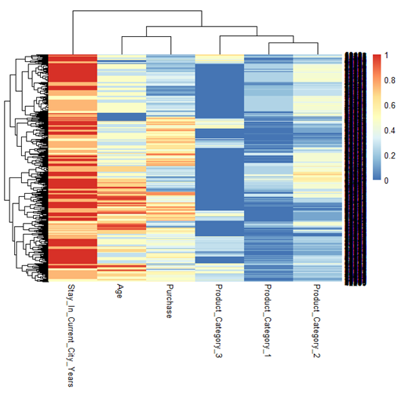
CLUSTERING USING K PROTOTYPE:
Visualizing cluster distribution of Numerical data.
CLUSTER- 1
Current City from long time.
City A
More Electronic Items purchase.
More Unmarried People.
More Female customers.

Slide 28
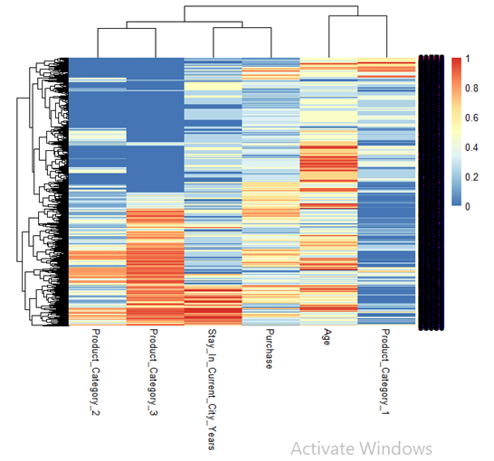
CLUSTERING USING K PROTOTYPE:
CLUSTER -2
Recently moved to their
Current city.
(OR) do not live in Current city.
Purchase home goods.
More married People.
More male customers.

Slide 29
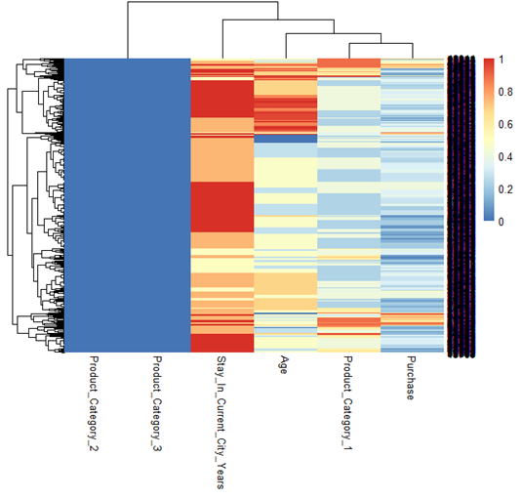
CLUSTERING USING K PROTOTYPE:
CLUSTER -3
Current City from long time.
City C
More Clothing Items purchase.
More married People.
More male customers.

Slide 30
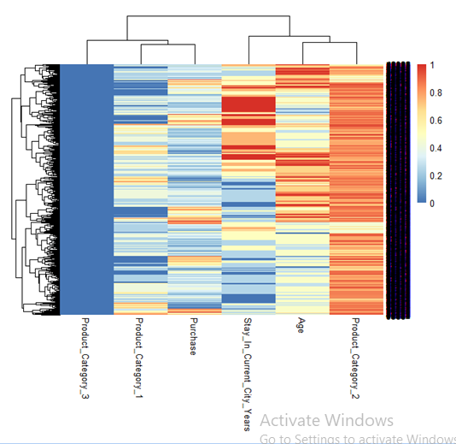
CLUSTERING USING K PROTOTYPE:
CLUSTER -4
live in Current city for quite few years.
City B and C
More purchase of Electronic Items along with Clothing.
More Unmarried People.

Slide 31
MODEL BUILDING
UNSUPERVISED LEARNING
ASSOCIATION RULES (Apriori Algorithm)
Can we attempt to associate products in order to perform product recommendation and organize store layout?

Slide 32
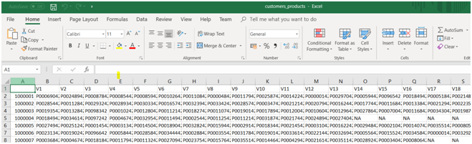
APRIORI ALGORITHM :
MODEL SPECIFIC PRE-PROCESSING :
Changing the data format : subset of the original data (User_ID and Product_ID)
Customer product table creation. (Spread())

Slide 33
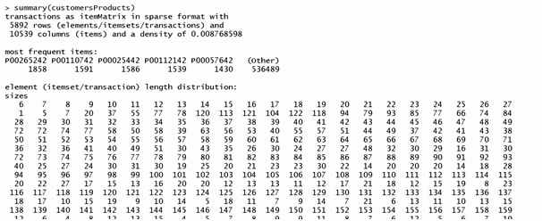
APRIORI ALGORITHM :
Sparse Matrix Creation :
Apriori doesn't take strings or text as input, but rather 1 + 0. (Binary Format)
Allocate a column for each product(1-User bought product / 0 - User didn't)
arules library : read.transactions() -> Sparse Matrix
rm.duplicates()-> Remove duplicates
No. of items in a customer basket.

Slide 34
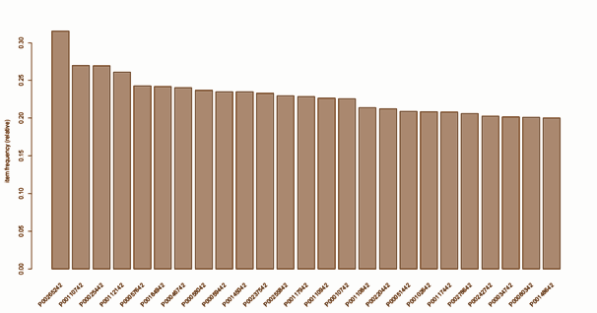
APRIORI ALGORITHM :
ITEM FREQUENCY PLOT :

Slide 35
APRIORI ALGORITHM :
TRAINING ASSOCIATION RULE MODEL :
Application of apriori algorithm to train and generate rules.
Main Parameters :
Support : min no. of transactions / Total no. of transactions.
Why? Setting min support value for our rules to take effect
Confidence : How often rule is to be found True
Why? To specify min strength of rule (default = 0.80)

Slide 36
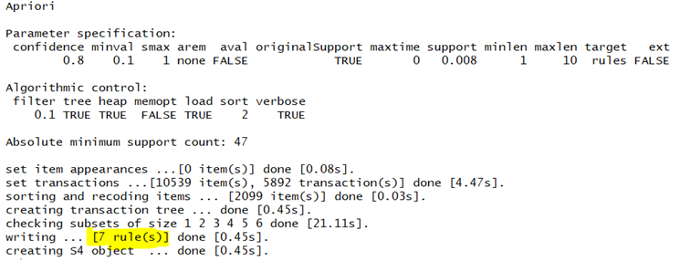
APRIORI ALGORITHM :
Apriori Result:

Slide 37
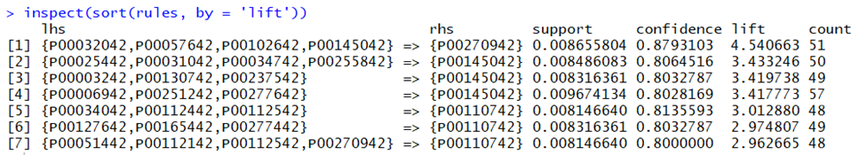
APRIORI ALGORITHM :
Rules generated:
Confidence/ Benchmark Confidence = Lift > 1 , indicates a rule that is useful in finding consequent item sets.

Slide 38
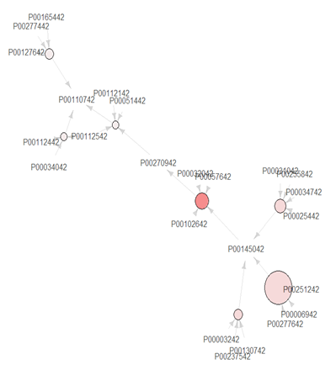
APRIORI ALGORITHM :
Visual Representation of Association Rules:
rules -> Graph for 7 rules
Size : Support
Color: Lift

Slide 39
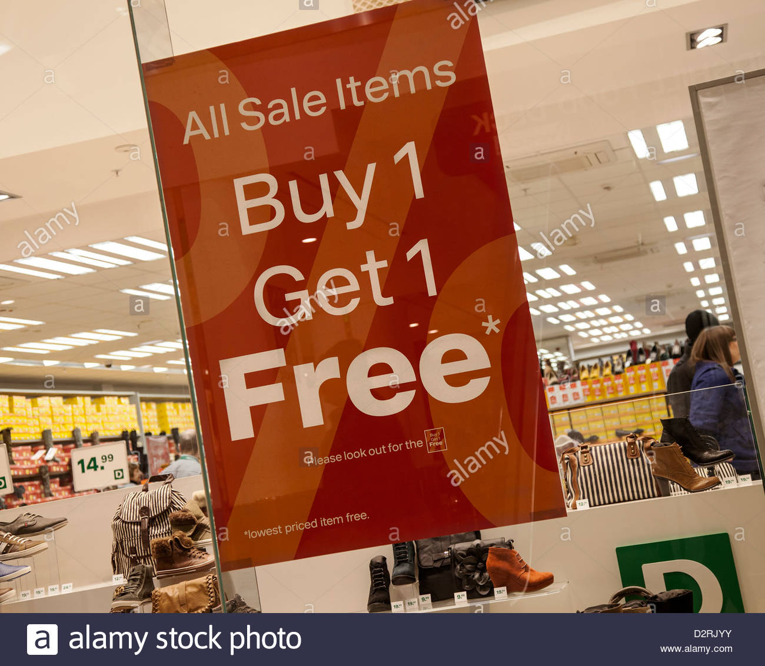
APRIORI ALGORITHM :
INSIGHTS :
Product Placement optimization
Promotional Campaigns
Online Recommendation System

Slide 40


Slide 41
THANK YOU !!

